Slide 1



Slide 2



COMMUNITY SERVICE PROJECT
TOPIC:- “ANDROID PHONE USAGE BY DIFFERENT PEOPLE”
DEPARTMENT OF COMPUTER SCIENCE & ENGINEERING

Slide 3

BATCH NUMBER : A9
NAME:
ROLL NUMBER:
LOCATION:
SK. JAFFAR SADIK
SK. SHAHUL
SK. AJMATULLA
B. VENKATESH
(222U1A3247)
(222U1A3250)
(222U1A3244)
(222U1A3203)
ATMAKUR
GUIDE NAME :
COORDINATOR :
HEAD OF THE DEPARTMANT :
CHAITANYA SIR
VENKATESHWARLU SIR
SAI PRASAD SIR

Slide 4

INTRODUCTION
Our Project deals with the Android Phone usage by different peoples in various Villages and the types of phone usage and to get awareness among the people and to get their life firster and smarter by the use of New Android Phone technologies and upgrade their life's by the upgrading technology.

Slide 5

ABSTRACT
In this Project, We Explore the Android Phone usage of various age group of people and to know how they are concentrated by their Android phone quality and type of company. Through this project we can know Android phone usage of different generations of the people. Our Project will not only shed's the light on the diverse ways people engage with Android Phones but also highlight the importance of considering user diversity in the development and marketing of mobile Applications.

Slide 6

EXISTING INFORMATION
A Smartphone is a mobile phone that offers more advanced computing ability and connectivity than a normal phone
smart phones do affect productivity, communication in work place, social engagement and have an effect in education. I support the statement above this is because almost everyone has a smart phone and they use them in almost everything they do daily.

Slide 7

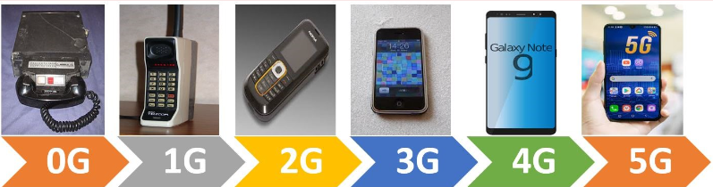
Generations of mobile phones
Mobile Generations is a system used by cellular telephone manufacturers and service providers to classify wireless communication into several generations; each generation is characterized by new frequency bands, higher data rates and non–backwards-compatible transmission technology. In the recent past, mobile wireless technologies have undergone technology evolution from 0G TO 5G.

Slide 8

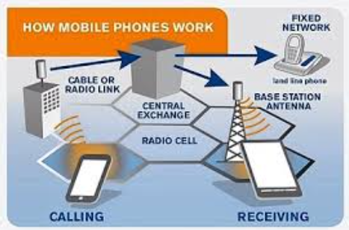
How mobile phones work
Mobile phone can make and receive telephone calls over a radio link whilst moving around a wide geographic area. It does so by connecting to a cellular network provided by a mobile phone operator, allowing access to the public telephone network.

Slide 9

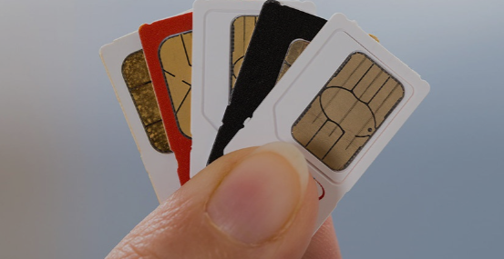
In Ghana, the mobile phone operators include:
Vodafone
Tigo
MTN
Airtel
jio
Express
You can enjoy their network
only when you have their sim
card inserted in your mobile
phone.

Slide 10
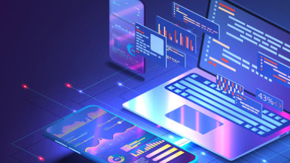
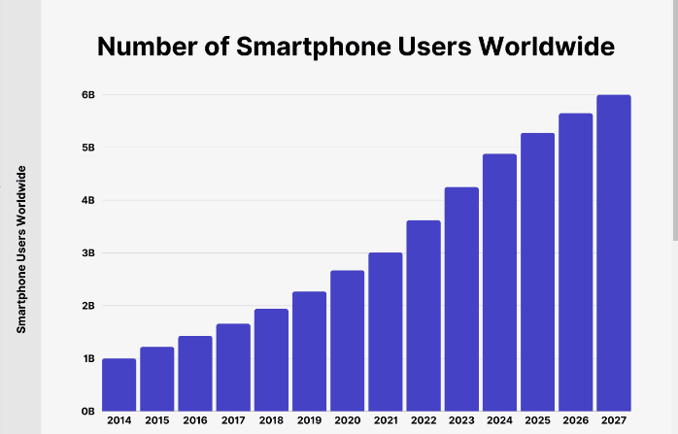
Android Phone Usage Around the World
From bustling cities to remote villages, the ubiquity of Android smartphones has transformed the way people connect, access information, and conduct their daily lives. Explore how users in diverse communities are embracing this technology.
Number of Smartphone Users Worldwide. As of 2024, an estimated 4.88 billion people own a smartphone. That's an increase of 635 million new smartphone users over the past year alone (between 2023 and 2024). Number of smartphone users worldwide grew by 2.15x since 2020, adding 2.61 billion new smartphone owners over time.

Slide 11

Smartphone Adoption in Rural Areas
Accessibility
Connecting Communities
Empowering Farmers
Affordable Android phones have made mobile technology accessible to underserved rural populations, bridging the digital divide.
Android apps provide farmers with real-time weather updates, crop-growing tips, and market prices, revolutionizing agricultural practices.
Instant messaging and social media apps allow remote villagers to stay connected with family and friends.

Slide 12

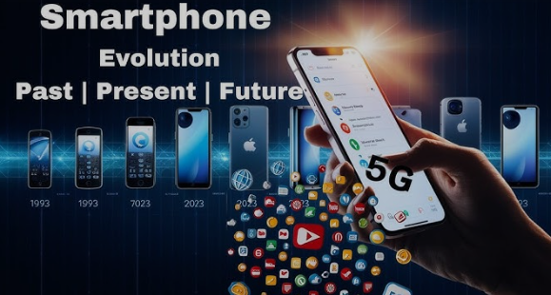
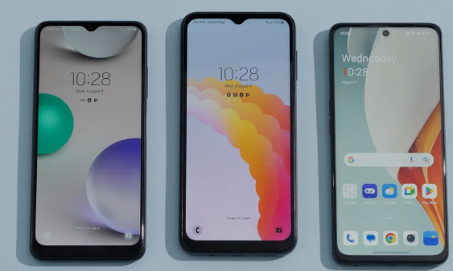
PROPOSING INFORMATION
The cellular communications networks are known by their numeric generation: 1G, 2G, 3G, 4G and 5G. We are currently fully deployed in 4G with 5G gaining ground. See also wireless LAN, wireless glossary and Wi-Fi vs.

Slide 13

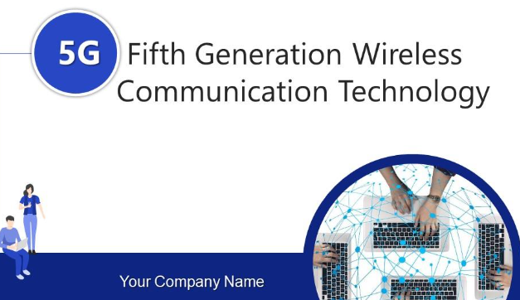
The most popular technology in 2024
The current generation of mobile phones is 5G, which is the fifth generation of mobile networks. 5G is a wireless standard that connects devices, machines, and objects together. It offers faster data speeds and lower latency times than previous generations, making it critical for technologies like virtual reality, augmented reality, and autonomous vehicles.
5G can be significantly faster than 4G, delivering up to 20 Gigabits-per-second (Gbps) peak data rates and 100+ Megabits-per-second (Mbps) average data rates. 5G has more capacity than 4G. 5G is designed to support a 100x increase in traffic capacity and network efficiency. 5G has lower latency than 4G.

Slide 14

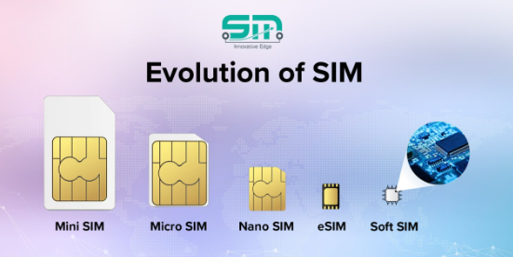
Evaluation of Sim Cards
The primary advancement in SIM card technology for mobile phones is the adoption of "eSIM" (embedded SIM), which eliminates the need for a physical SIM card by integrating the SIM functionality directly into the phone's hardware, allowing users to switch carriers or activate service remotely without swapping a physical card; this is considered a major upgrade in convenience and flexibility compared to traditional SIM cards

Slide 15
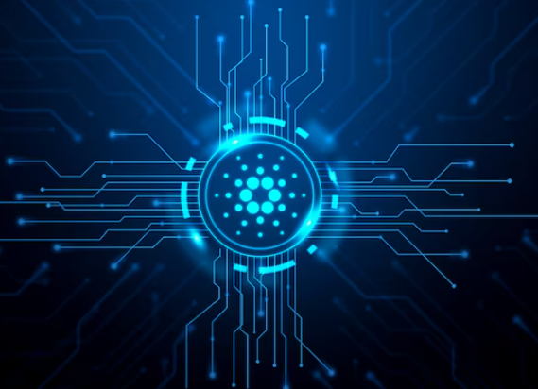
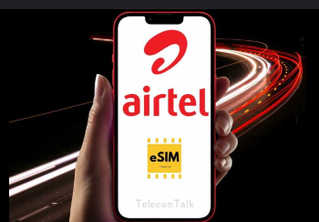
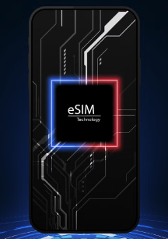
Key points about eSIM technology:
No physical card needed:
Unlike traditional SIMs, eSIMs are embedded within the
phone, removing the need to insert a physical card.
Remote provisioning:
Users can activate or switch carriers through software
settings, eliminating the need to visit a store.
Multiple profiles:
A single eSIM can store multiple carrier profiles,
allowing users to easily switch between plans without
changing cards.
Smaller footprint:
By eliminating the physical SIM slot, phone
manufacturers can utilize more space for other
components.

Slide 16

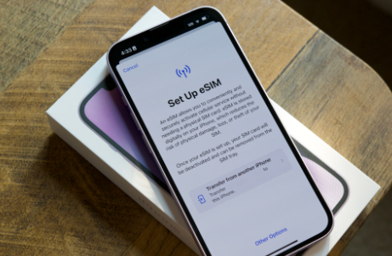
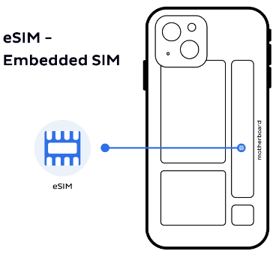
Evolution of SIM card sizes:
Standard SIM: The original large SIM card
Micro SIM: Smaller version, commonly used before the widespread adoption of eSIM
Nano SIM: Even smaller size, currently being replaced by eSIM in newer phones

Slide 17
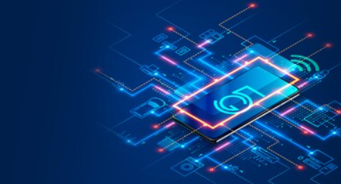
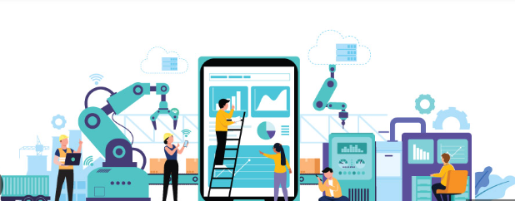
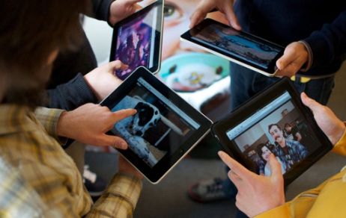
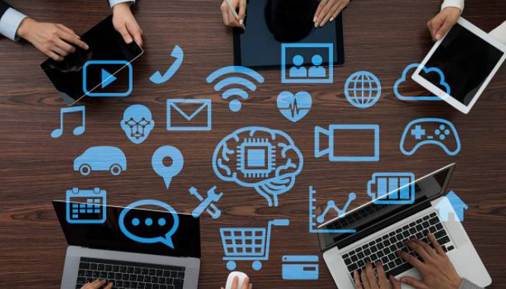
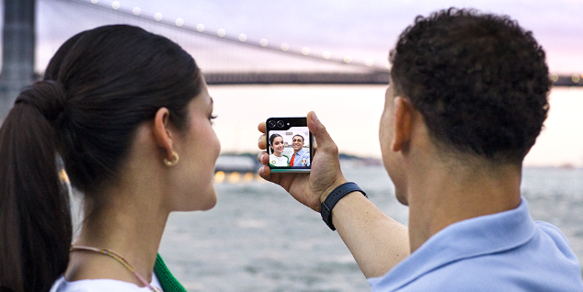
Teens and Smartphones: A Love Affair
Constant Connectivity
Productivity Tools
Mobile Entertainment
Self-Expression
Teens rely on their Android phones to stay connected with peers, share experiences, and express themselves
Streaming music, videos, and games on Android devices provide endless entertainment for tech-savvy teenagers.
Android apps help schedules, collaborate on projects, and access educational resources.
Customizable Android interfaces and social media platforms allow teens to showcase their unique personalities.

Slide 18

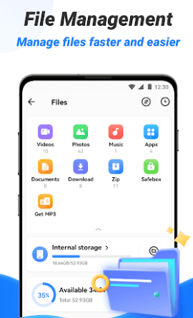

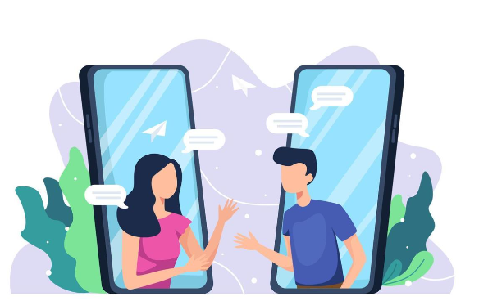
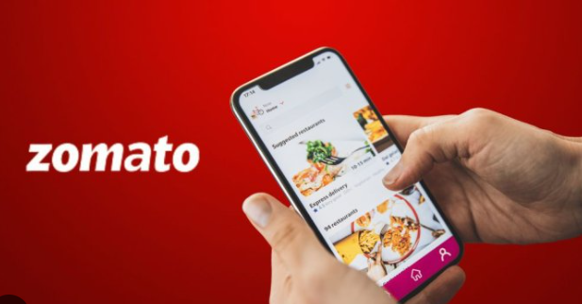
Android in the Workplace
Communication
Organization
File Management
Collaboration
Productivity apps on Android devices help workers manage their schedules and tasks.
Android's cloud storage integration enables seamless access to important files and documents.
Video conferencing apps on Android facilitate remote meetings and team collaboration.
Android's email and messaging apps keep professionals connected and responsive.

Slide 19

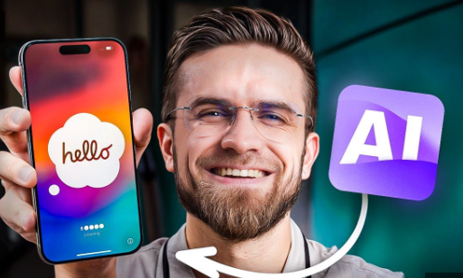
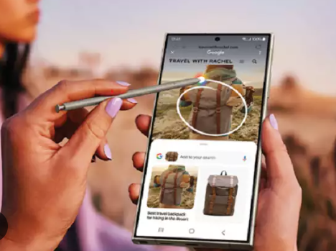
Upgrading AI Mobile Technology
AI refers to the simulation of human intelligence in machines that are programmed to think and learn. It is a broad field encompassing everything from machine learning algorithms, which adapt and learn from new data to natural language processing that enables devices to understand and respond to human speech. AI’s goal is to enhance machine functionality, enabling them to perform complex tasks with a degree of autonomy.

Slide 20
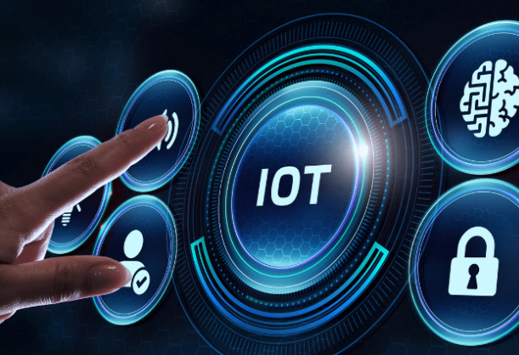
INTERNET OF THINGS
The Internet of Things (IoT) plays a key role in mobile phones by allowing users to interact with and control a variety of devices, including smart thermostats, security cameras, and lighting systems. IoT mobile apps can:
Connect devices
Connect to smart devices through Bluetooth, Wi-Fi, RFID, NFC, and other networks
Communicate with devices
Receive input from users through cameras, gesture recognizers, and voice, and
communicate with devices through connected mediums
Collect and store data
Collect data from connected devices, analyze it, and store it in the cloud
Provide insights
Provide health insights through wearable devices, or track the location of a person or
object in real time
Automate processes
Automate processes and provide user-friendly features to increase efficiency and
productivity

Slide 21
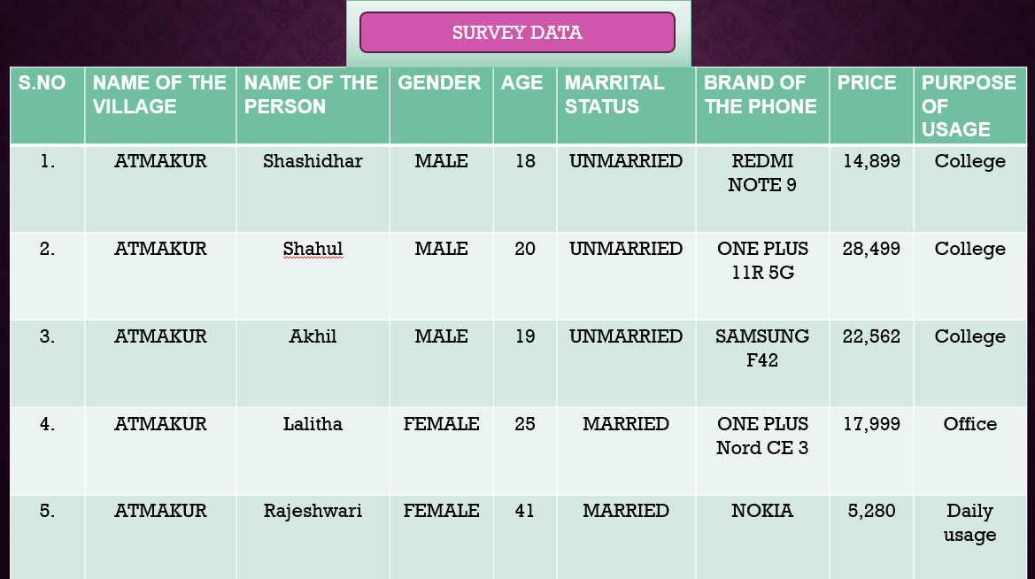

Slide 22
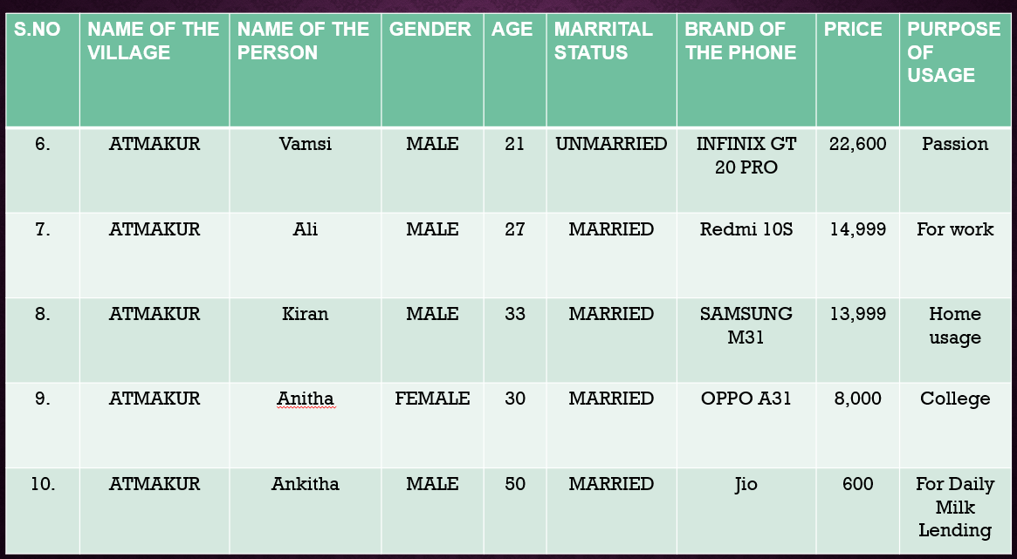

Slide 23
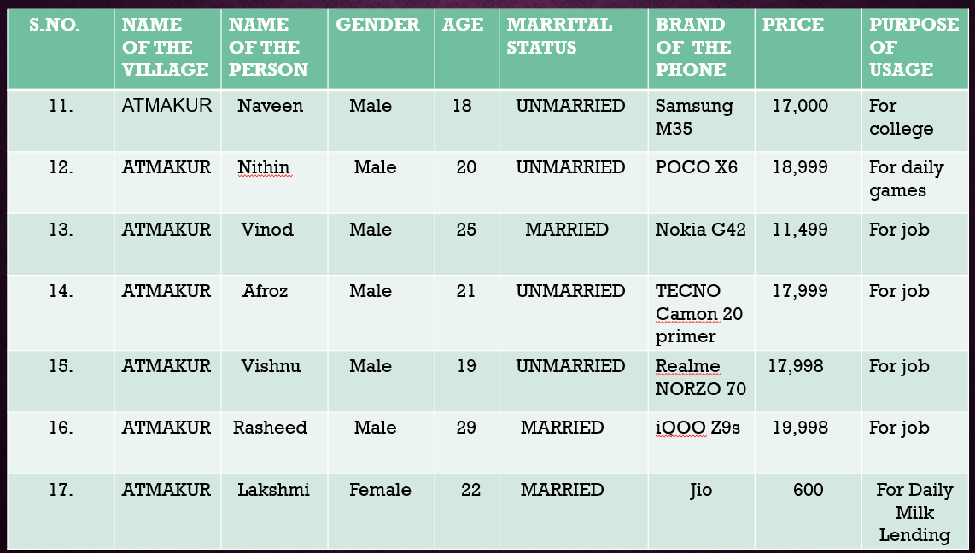

Slide 24
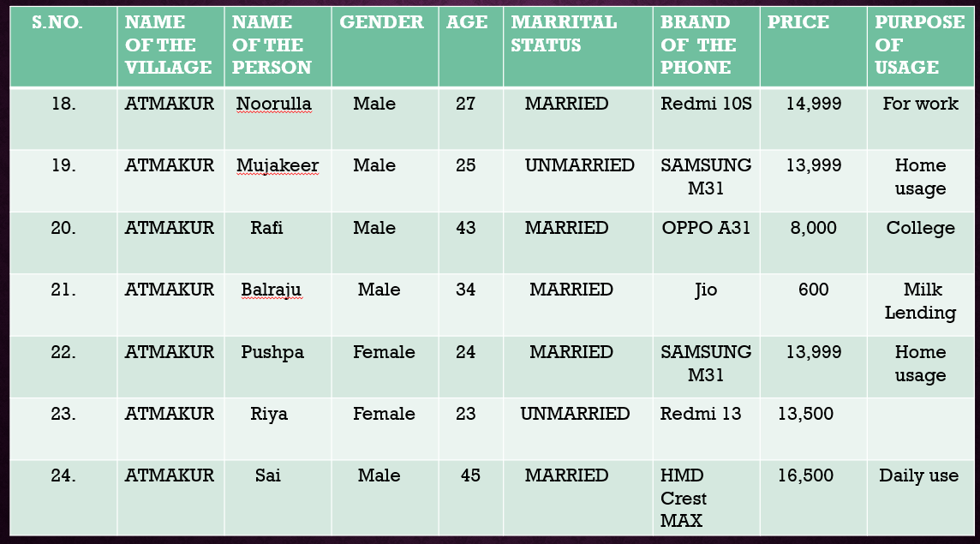

Slide 25
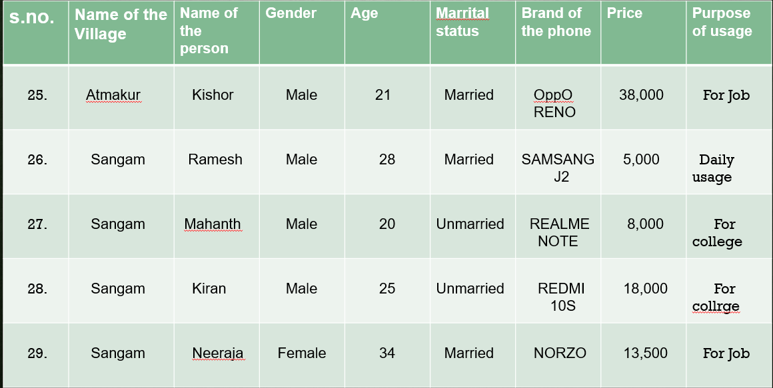

Slide 26
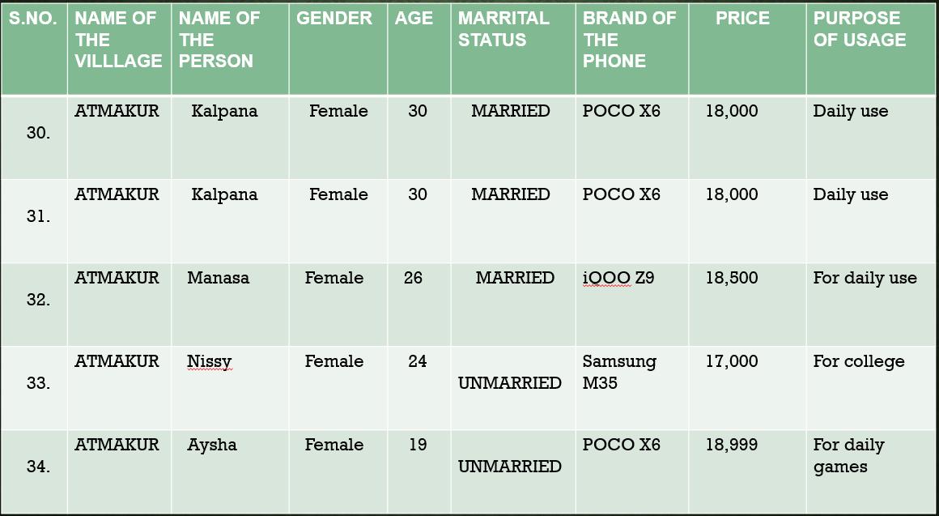

Slide 27
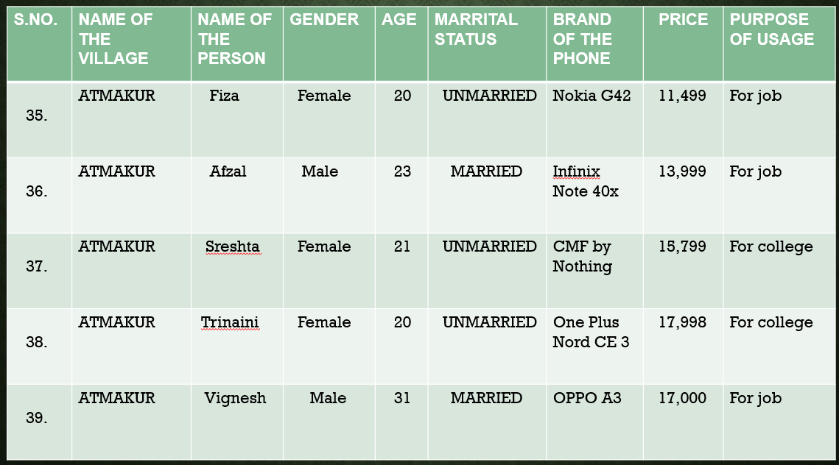

Slide 28
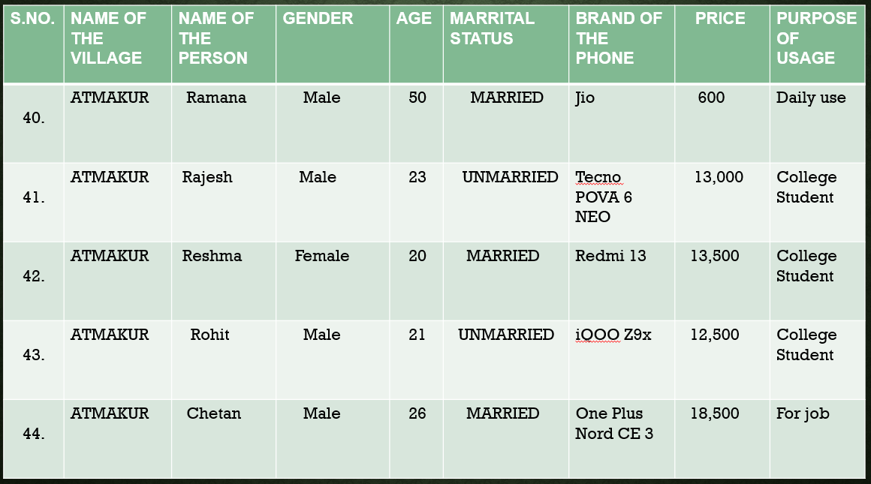

Slide 29
S.NO | NAME OF THE VILLAGE | NAME OF THE PERSON | GENDER | AGE | MARRITAL STATUS | BRAND OF THE PHONE | PRICE | PURPOSE OF USAGE
45. | ATMAKUR | Afzal | Male | 23 | Married | Redmi | 16,499 | For job
46. | ATMAKUR | Mujameel | Male | 19 | Unmarried | OPPO A31 | 13,813 | For College
47. | ATMAKUR | Chinni | Female | 18 | Unmarried |  | 8,990 | For social media
48. | ATMAKUR | Mahesh | Male | 21 | Unmarried | Nokia | 1,699 | For College
49. | ATMAKUR | Abdulla | Male | 22 | Unmarried | Honar X8B | 12,999 | For Daily use
50. | ATMAKUR | RAHAMAN | Male | 23 | Unmarried | Samsung J2 | 7,000 | For daily use

Slide 30

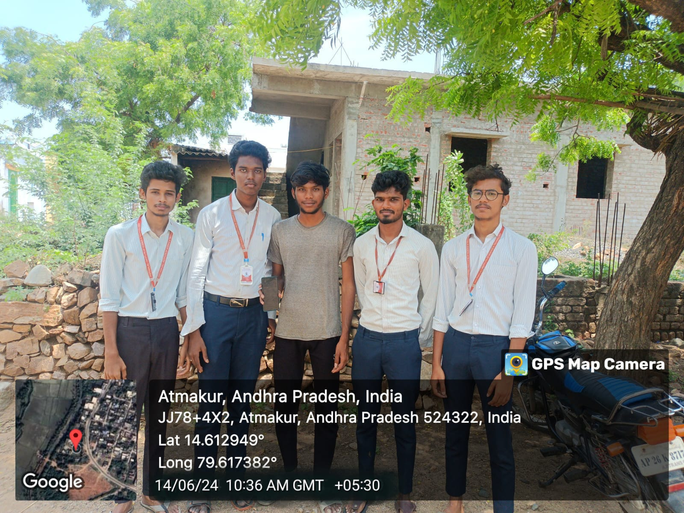
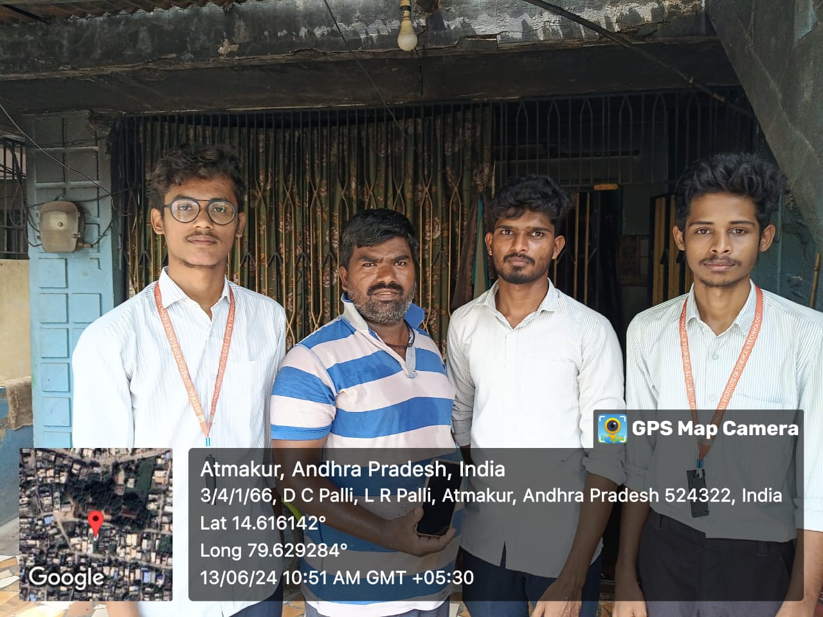
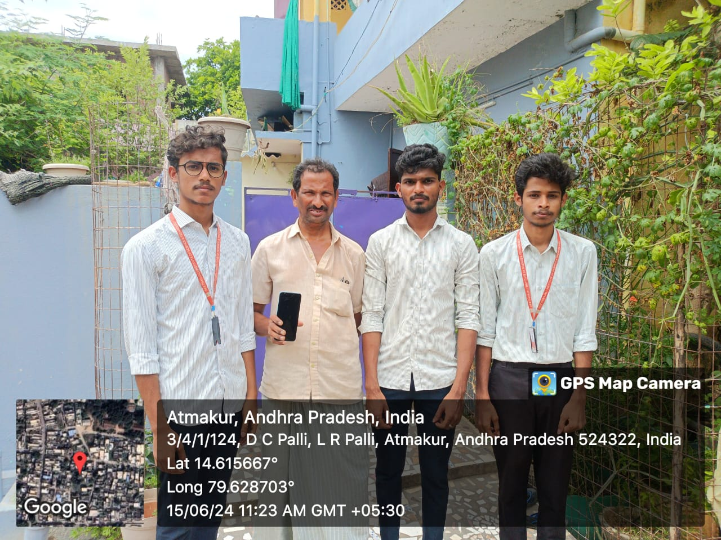
SURVEY PHOTOS

Slide 31

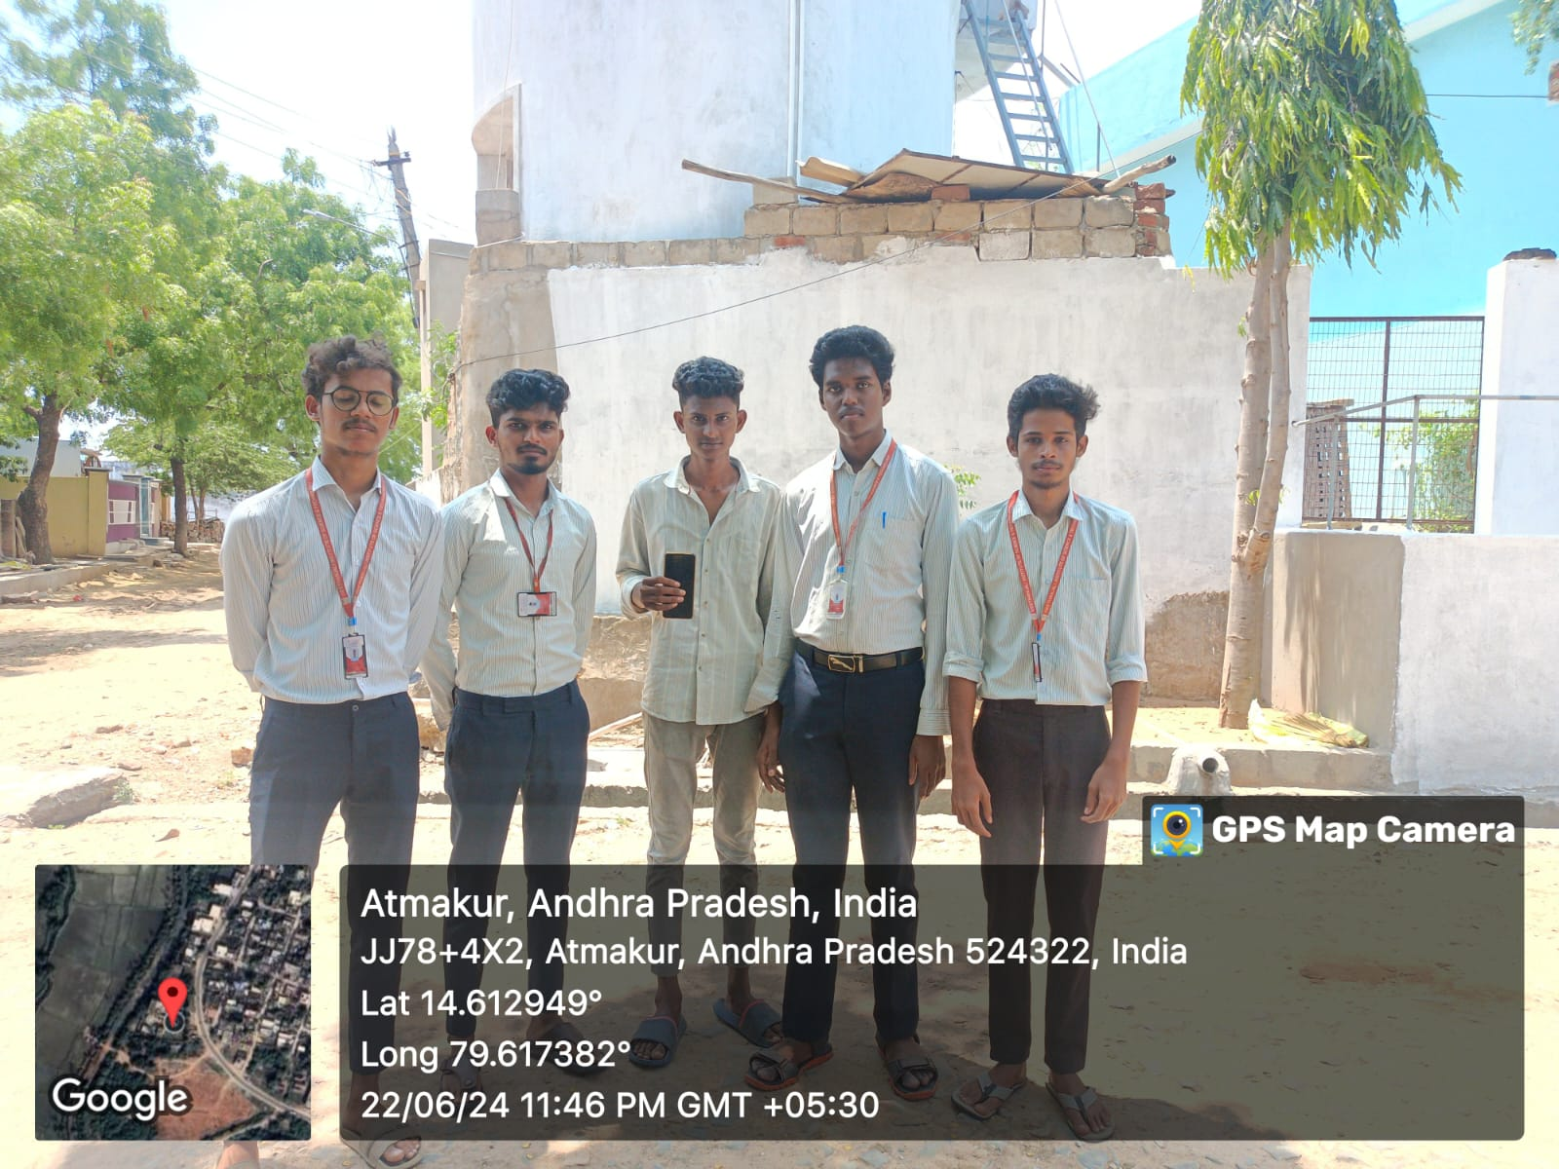
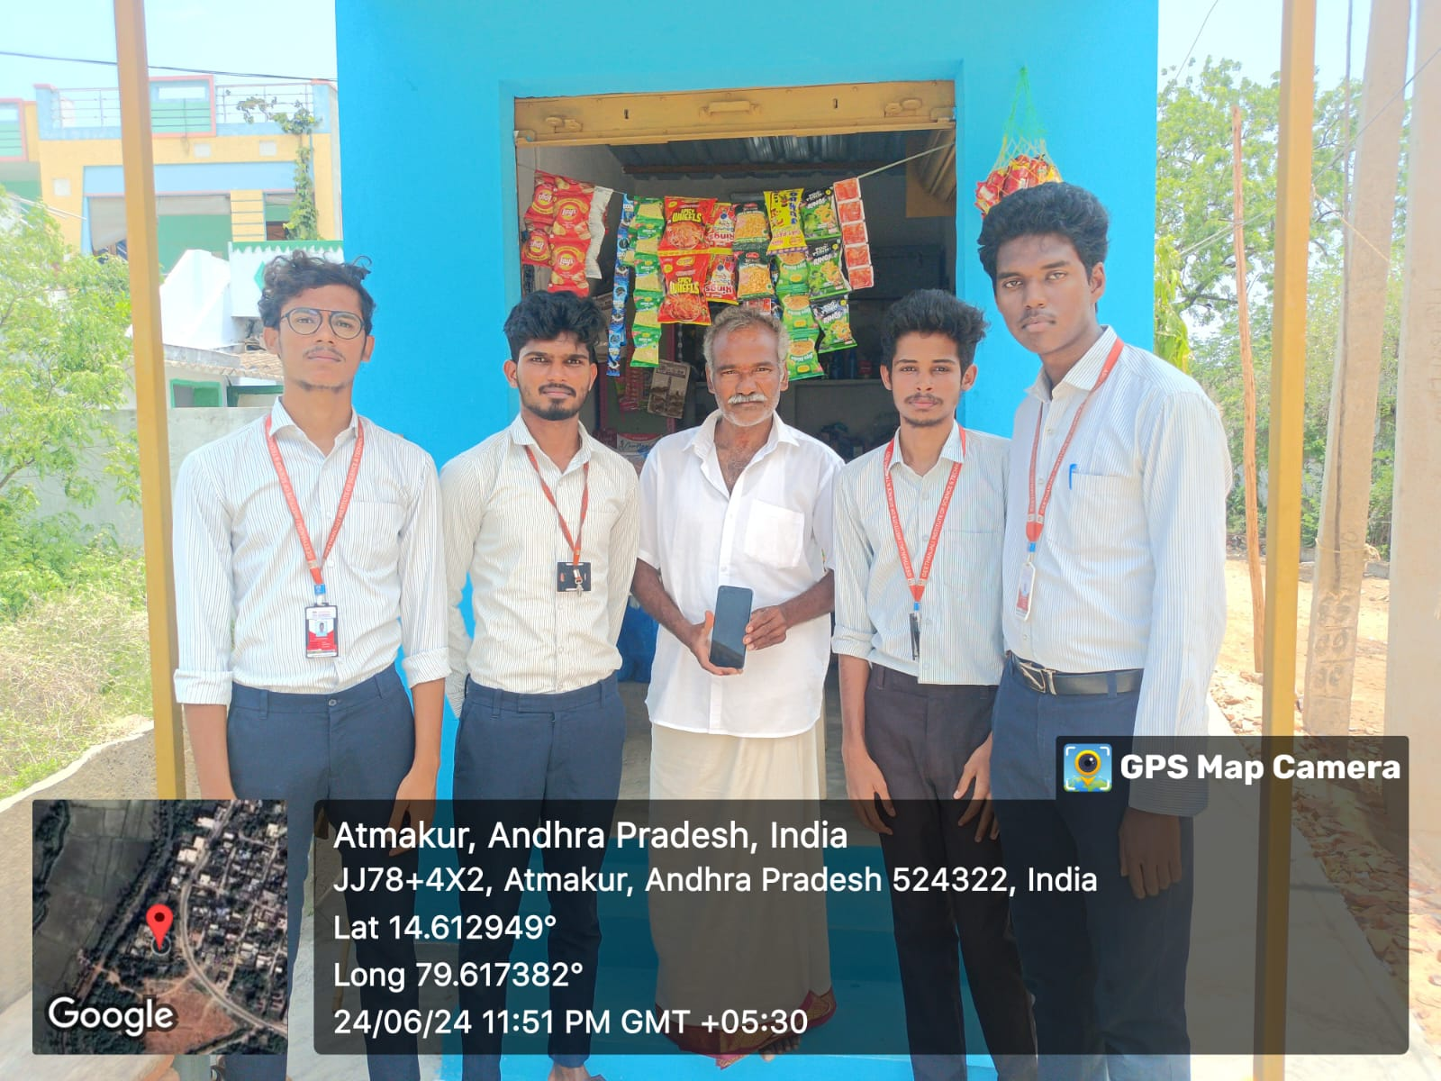
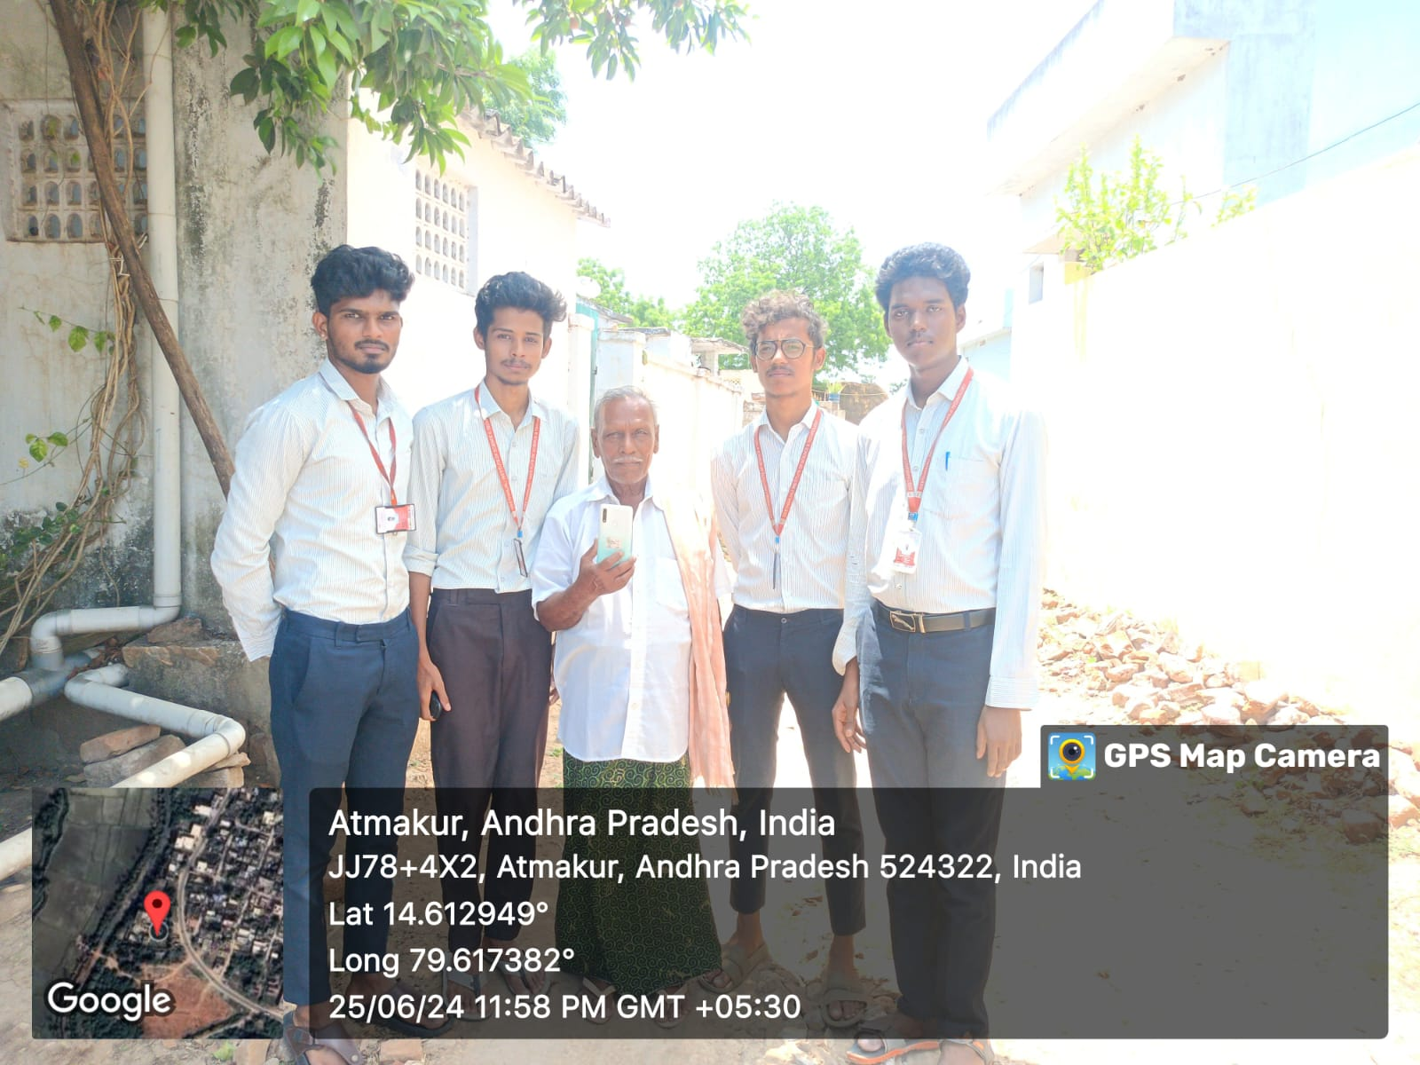

Slide 32

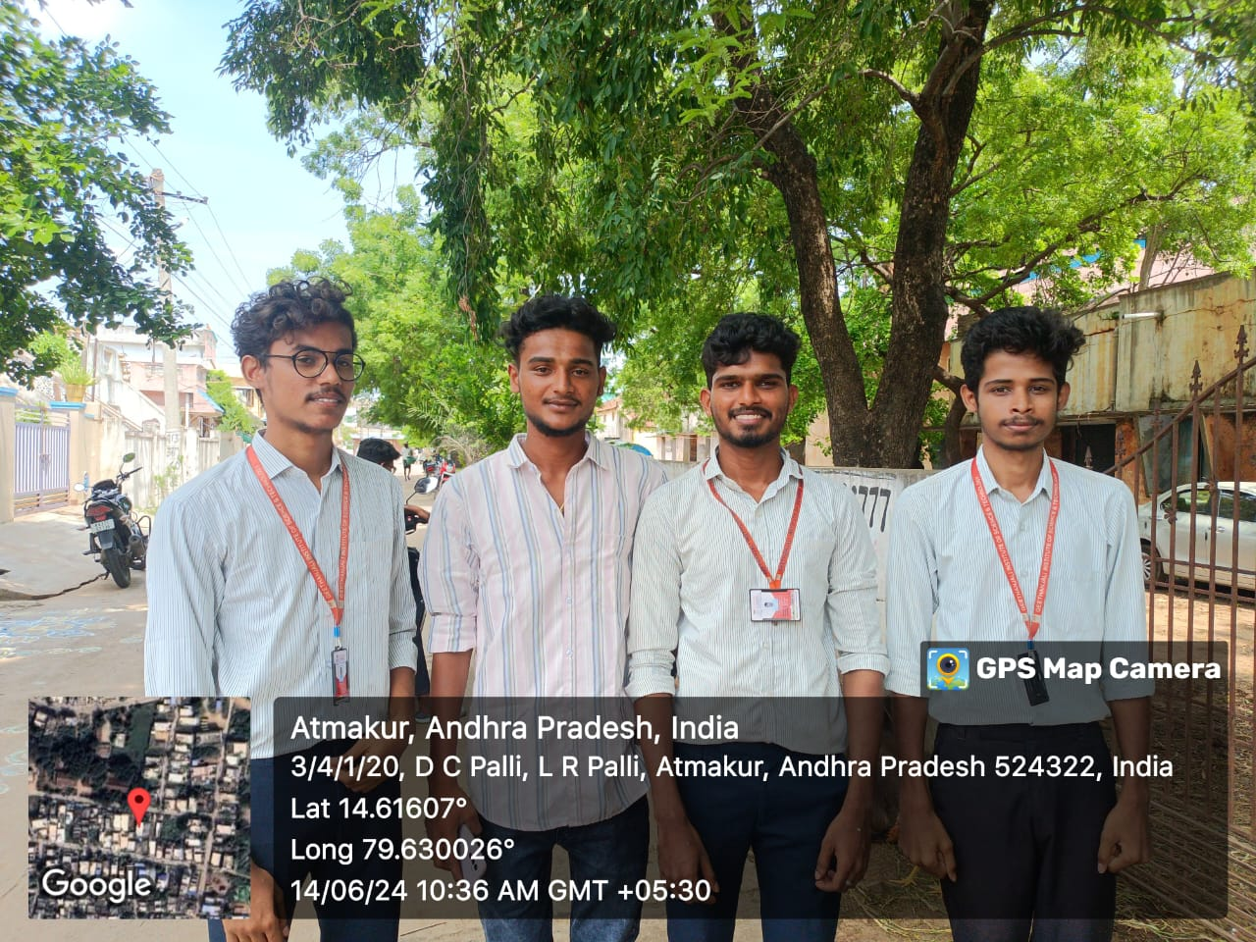

Slide 33


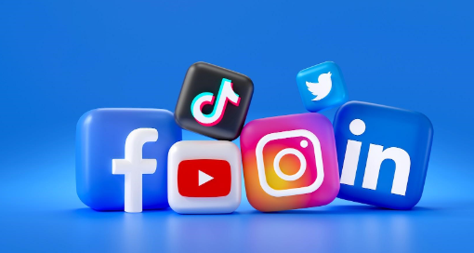
BY THE SURVEY WE CONCLUDE THAT !
Firstly we conclude the mobile phones are very beneficial.
At the same time they also causes lots of disadvantages.
They create distance between people.
As people spend time on their phones and they don’t talk to each other much.
There are some there are some disadvantages like:-
children in the age group of (5 – 15) they are using the phone for the purpose of Games, they will addict to the mobile.
Adults in the age group of (16 – 20) they are using the phone for the purpose of social media.
Old age people they are using the phone for contact with their children.

Slide 34

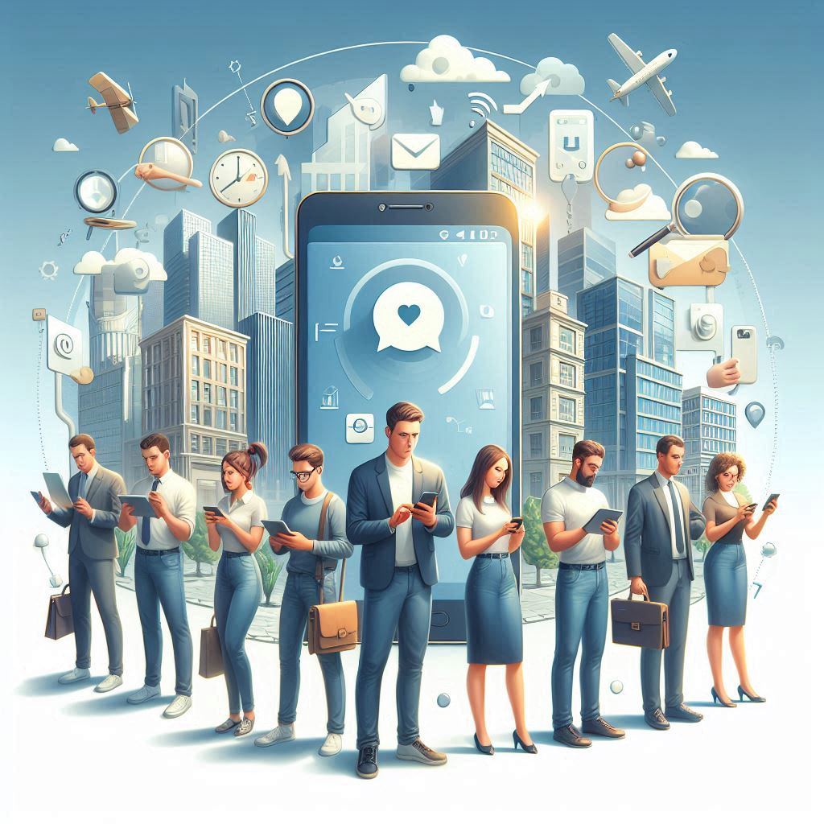
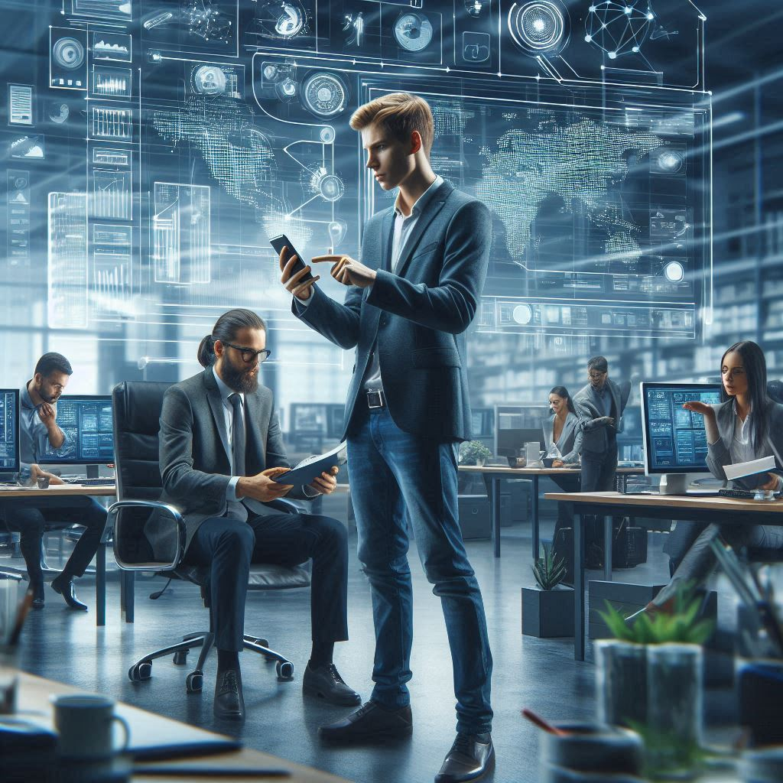
The mobile phone addiction in the present generation

Slide 35

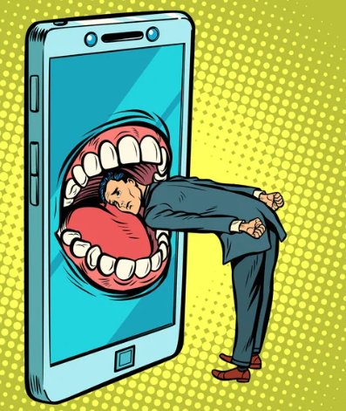
Precautions to avoid the mobile phone usage in the society
To avoid excessive mobile phone usage in society, individuals can practice mindful phone habits like: setting designated "phone-free" times, keeping phones out of sight during social interactions, being aware of surroundings, using apps to limit screen time, turning off notifications when not needed, prioritizing face-to-face conversations, and consciously choosing to put the phone away during important moments like meals or meetings.

Slide 36



Key precautions to avoid excessive mobile phone usage:
Set boundaries:
Designate specific times and places where phone usage is restricted, like during meals, meetings, or while driving.
Silence notifications:
Mute unnecessary notifications to avoid constant distractions.
"Phone-free" zones:
Establish designated areas where using phones is discouraged, such as in classrooms or during social gatherings.
Digital detox:
Schedule regular periods without phone access to encourage present-moment engagement.
App management:
Remove time-consuming apps or set usage limits on them.

